Slide 1
Management Madness
Team 15 Final Project Report

Slide 2
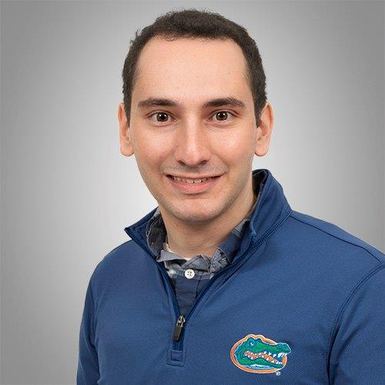


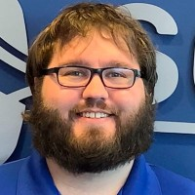
Meet Team 15
Matt Rosenthal
Matt Royalty
Michael Munson
Jeffrey Sumner

Slide 3
Background Information and Problem
The NCAA March Madness tournament is a popular event that attracts millions of viewers and generates significant revenue from sports betting
Predicting the outcome of the tournament is a challenging task due to the many variables involved, such as possible upsets, player injuries, and changing data
Various analyses, such as live win probabilities, excitement index, and Elo ratings, are used to predict the outcomes of matchups throughout the basketball season
The goal of the project is to create machine learning models that can predict the outcome of NCAA games based on different matchups and pre-game statistics
Notes:
Project Scope – we started with a lot of different ideas like most groups – predicting on soccer data, predicting airline delays, etc but decided to ultimately predict NCAA tournament attendance and win probabilities
Data Prep – lots of data sources ranging from R packages to espn to college and university information. Each had to be pulled and assessed for completeness and useability. Lots of feature engineering takes place

Slide 4
Data Gathering and Cleaning
The project gathered data on college basketball games between 2012 and 2022, including game outcomes, betting odds, and AP poll rankings, using web scraping and querying APIs.
Some notable dataset repositories:
Kaggle "Mens March Mania"
Kaggle "College Basketball Dataset – Andrew Sundberg"
Some notable packages that we used (which you can find on Github):
NcaahoopR
hoopR
Web scraping from sports-reference.com and espn.com
rvest()
ESPN API
We wrote many scripts which filtered, renamed variables, geocoded college locations, and merged data frames.
Notes:
Project Scope – we started with a lot of different ideas like most groups – predicting on soccer data, predicting airline delays, etc but decided to ultimately predict NCAA tournament attendance and win probabilities
Data Prep – lots of data sources ranging from R packages to espn to college and university information. Each had to be pulled and assessed for completeness and useability. Lots of feature engineering takes place

Slide 5
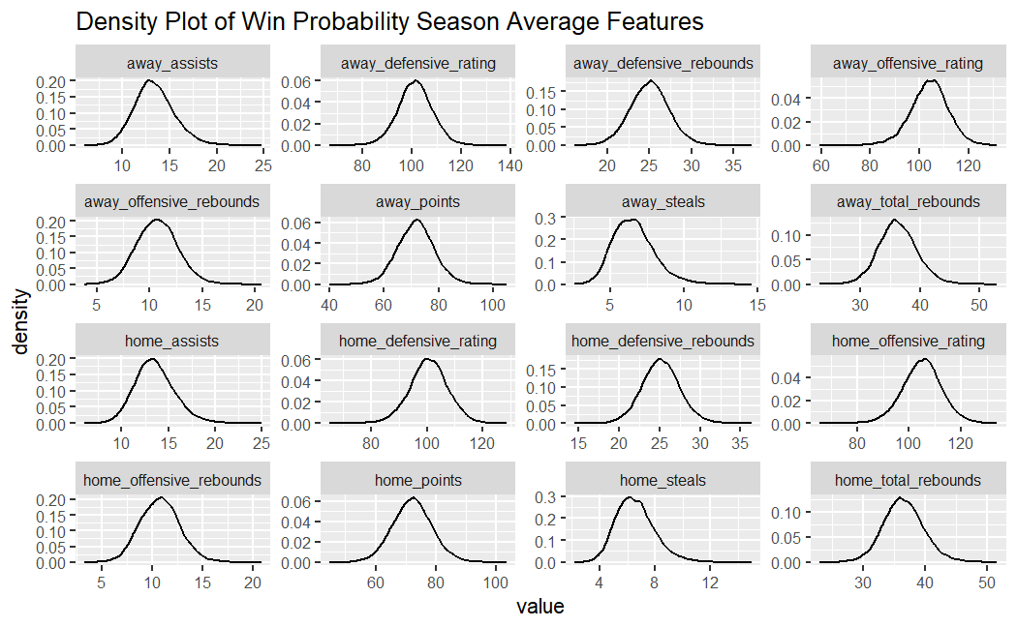
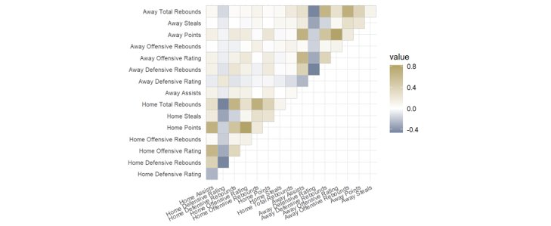
Data Exploration
Many features in our dataset are naturally correlated
Offensive rating and average points per game
Home team and away team
Low correlation in most comparable stats
Home team average rebounds per game was not correlated with away team average rebounds per game
Many features with centers close to zero had to be dropped from the data​
Technical and flagrant fouls, blocks
Correlation plot highlighting a few features
Note: Results based on Training data
Note: Results based on Training data
Notes:
Project Scope – we started with a lot of different ideas like most groups – predicting on soccer data, predicting airline delays, etc but decided to ultimately predict NCAA tournament attendance and win probabilities
Data Prep – lots of data sources ranging from R packages to espn to college and university information. Each had to be pulled and assessed for completeness and useability. Lots of feature engineering takes place

Slide 6
Feature Engineering and Final Dataset
Team offensive and defensive efficiency ratings
calculated using offensive points per 100 possessions and defensive points allowed per 100 possessions
Possessions
using a formula to calculate the number of possessions per game
Rolling 5 game average and season average
game statistics for each team up to the game of interest
aiming to reduce noise in the data and identify trends
Distance traveled to the game site
used data on game site longitude and latitude, home arena information, and away arena information
Ended up with a dataset of 45,518 data points, each representing a single game and containing 237 features of game statistics and engineered features.
Notes:
Project Scope – we started with a lot of different ideas like most groups – predicting on soccer data, predicting airline delays, etc but decided to ultimately predict NCAA tournament attendance and win probabilities
Data Prep – lots of data sources ranging from R packages to espn to college and university information. Each had to be pulled and assessed for completeness and useability. Lots of feature engineering takes place

Slide 7
Modeling Process Overview
Splitting the data into train, test, and validation sets
Establish baseline models
Feature selection
Simple models with feature selection
Enhanced models with feature selection
All model comparison
 | Baseline | Simple | Enhanced
Algorithm | Logit, Probit | Logit, Probit | Logit, XGB
Feature Selection? | N/A | Lasso regression; optimal lambda | LASSO regression; optimal lambda
Feature Engineering | N/A | N/A | Normalization, PCA (80% threshold)
Cross-validation | N/A | Lambda optimization | k-fold cross validation to optimize ROC and AUC
Data Used | Season, Rolling | Season, Rolling | Season, Rolling

Slide 8
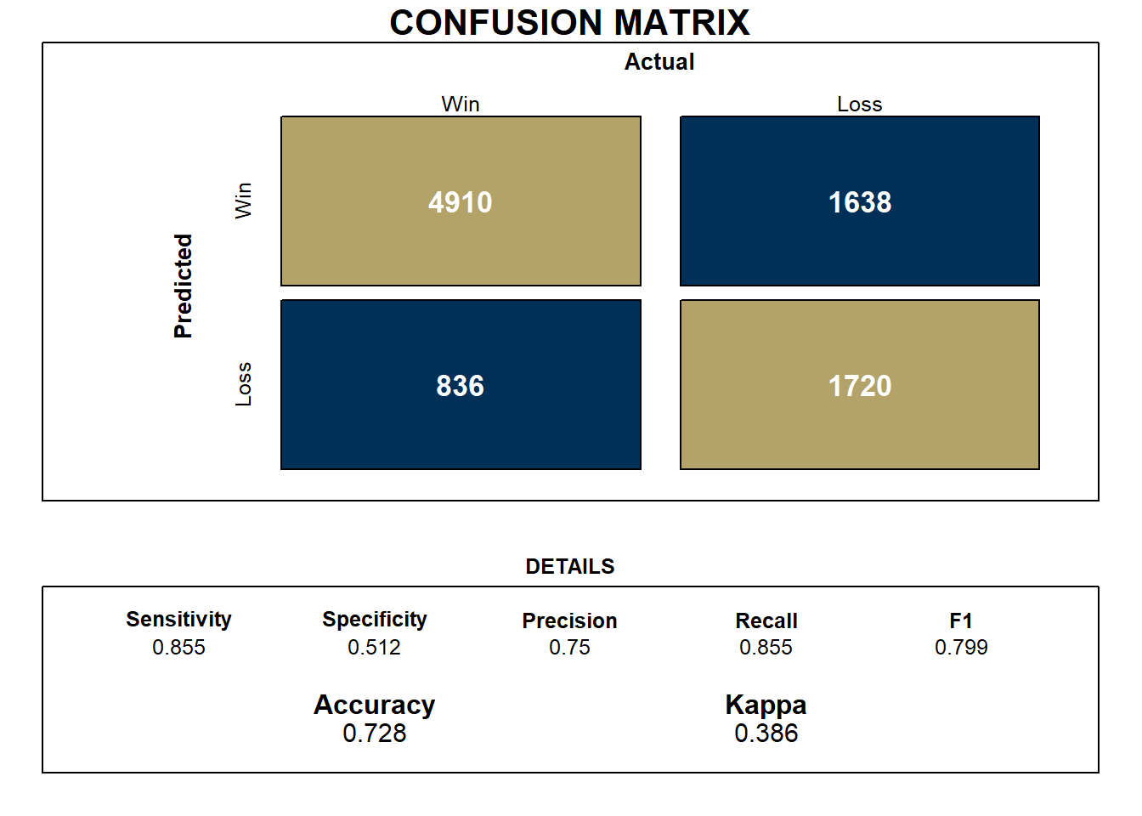

Baseline Models
ESPN baseline accuracy roughly 72.8% and precision of 75%
Team 15 baseline accuracy built upon season averages roughly 71.8% and precision of 74%
ESPN Baseline
Team 15 Baseline
Note: Results based on Validation dataset predictions
Note: Results based on Validation dataset predictions

Slide 9
Feature Selection
Feature selection:
Explored feature selection using stepwise regression and LASSO regression
Selected 30 features for season averaged data and 44 features for rolling averaged data
Significant predictors:
offensive ratings, blocks, field goals attempted, assists, turnovers, steals, ratings, distance traveled

Slide 10

Simple Models
Goal: Maintain precision and reduce overfitting
Approach:
Logistic Regression and Probit Regression (glm)
Input features were selected with LASSO regression
No normalization, PCA or cross-validation performed
Result:
Reduced the number of input features while maintaining similar accuracy and precision levels as our baseline models
Multicollinearity still an issue among some input features
Challenges
Occasionally models would predict all wins or all losses
Note: Results based on Validation dataset predictions

Slide 11

Enhanced Models
Goal: Further reduce overfitting, increase model stability, and maintain precision
Approach
Logistic Regression (glmnet) and Gradient Boosted Decision Trees (xgboost)
Tidymodels framework for hyperparameter tuning
Input features were selected with LASSO regression, normalized and PCA (captured 80% of variance) was used to minimize multicollinearity
10-fold cross-validation to optimize on ROC and AUC
Result
Small boost to specificity compared to simple model but decline compared to baseline
Multicollinearity issues were removed
Challenges
Occasionally models would predict all wins or all losses
Xgboost tuned many different parameters and resulted in longer than desired run-times
Note: Results based on Validation dataset predictions

Slide 12
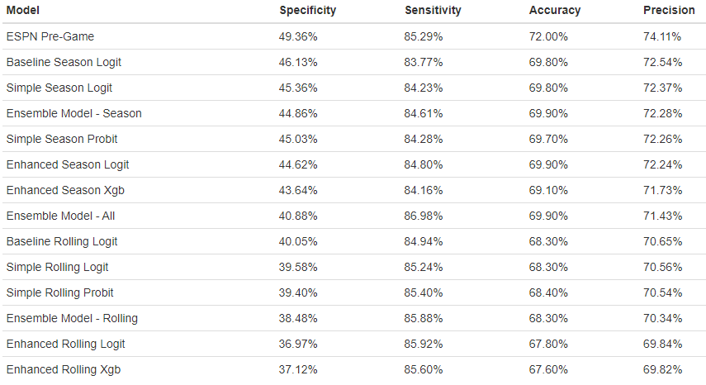
Model Comparison
Using season-average statistics leads to a more precise model than rolling statistics
Difference in logit and probit models is negligible
Using a decision tree model doesn't lead to improved performance
Ensemble model performs similarly to single models
Best accuracy (season) aside from ESPN
Note: Results based on Test dataset predictions

Slide 13
Overall Results and Next Steps
We were able to develop models with comparable results to ESPN's Pre-Game model
Clearly-identified factors vs. "black box" ESPN model
Next steps to improve our models:
Using other thresholds than 0.5 for different bettors' risk levels
Trying alternative feature selection methods (like stepwise)
Integrating individual player statistics into the prediction models
Operationalizing our models on next season's college basketball games
Future models to consider:
Predicting specific bets (like Over/Under and Points For)
Predicting betting lines
Predicting game attendance

Slide 14
Sources
Sources cited on the last slide (no need to read them just include them).
March Madness Betting Expected to Exceed $3 Billion, Set All-Time High (newsweek.com)
March Madness: How a fan used a machine to nail his bracket - Sports Illustrated
Advertisers Go Mad For March Madness - TV News Check

